Slide 1

DMIT104 Programming Fundamentals (in C#)
Day 1– Introduction to Visual Studio 2008

Slide 2
Learning Outcome Guide
At the end of this topic, you should be able to
(Understanding/Knowledge)
Define the term IDE
List the key tools available in Visual Studio 2008
Describe the relationship between Solutions, Projects and Files in Visual Studio 2008
List three different types of projects in Visual Studio 2008
List three different web site templates in Visual Studio 2008
Describe the following parts of the Visual Studio IDE:
Editor Window, Toolbox, Solution Explorer, Server Explorer, Error List, Output Window
Identify the file extension for a Solution file
(Ability)
Create a Console project
Configure the tool options in Visual Studio
Ensure the Solution file (.sln) and Website folder are in the same location

Slide 3
Work on your C:\ Drive
Don’t do your Visual Studio work in
My Documents
Desktop
USB Drive
Do your Visual Studio work in
A folder on the root of your C:\ drive, such as
C:\DMIT\YourName\DMIT104

Slide 4
Visual Studio 2008 – IDE
IDE – Integrated Development Environment
Coding Tools
Editor, File/Project Management
Intellisence
Debugger
Database Tools
Server Explorer
Collaboration Tools
Team Server Edition ($)
AnkhSvn (free)

Slide 5
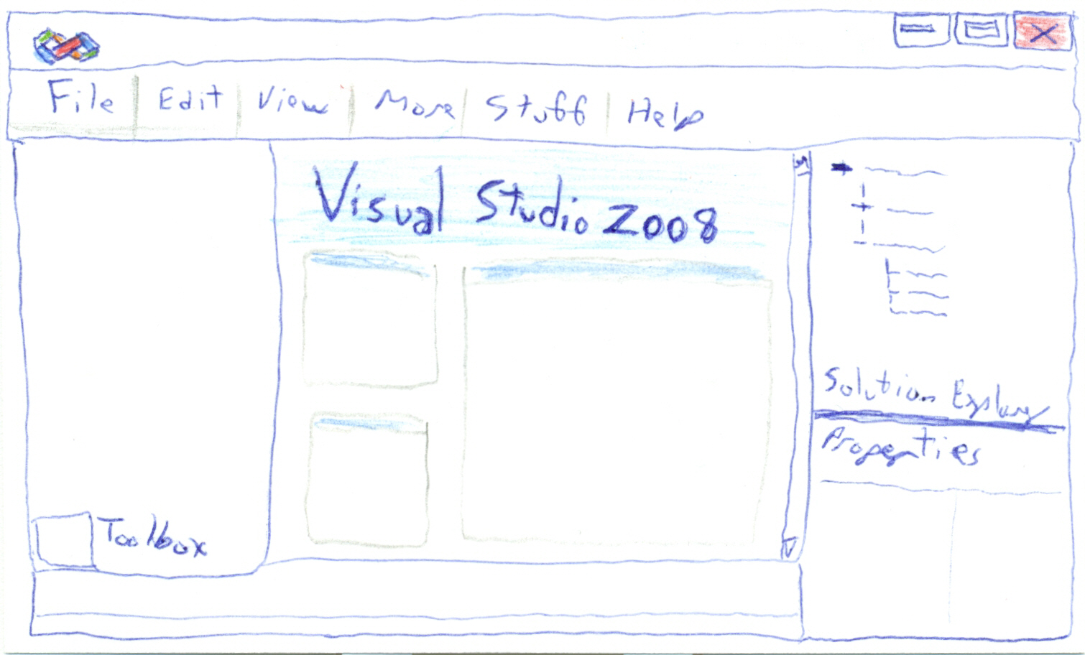
Visual Studio 2008 – IDE

Slide 6
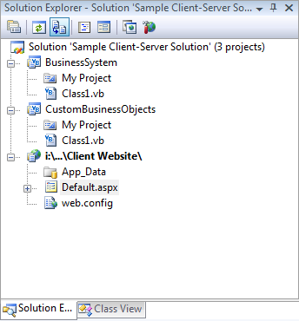
Solutions – Projects – Files
Solution
A collection of zero or more projects
Solution File
.sln
Plain text
Project
An Executable (.exe/.dll)
.vbproj
Plain text (XML)
A Website
Files
Source code (classes)

Slide 7
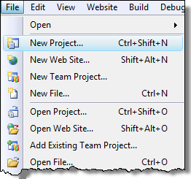
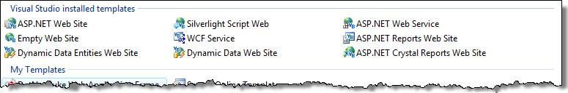
Creating Projects (Solutions)
New Project… (C#)
Console applications
Class Libraries
Windows applications
Database projects
Etc.
New Web Site…
Web sites

Slide 8
Work on your C:\ Drive
Don’t do your Visual Studio work in
My Documents
Desktop
USB Drive
Do your Visual Studio work in
A folder on the root of your C:\ drive, such as
C:\DMIT\YourName\DMIT104
Please remember this – it will save hours of your life!

Slide 9
Creating Websites
Create New Console Application
File -> New Project...
.NET Framework 3.5
Console Application
Choose Location
Enter Project Name
Enter Solution Name

Slide 10

Solution Explorer
Explore what’s in your Solution
Projects
Files
Conceptual View
Not Physical
Startup Project/Website

Slide 11
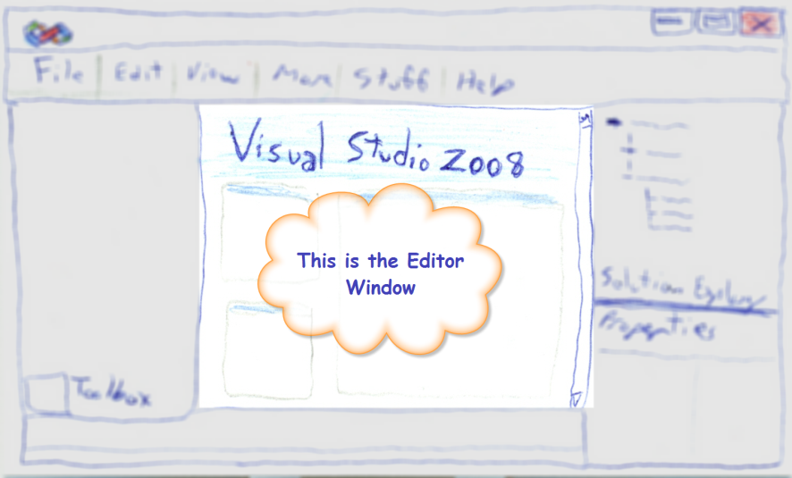
Editor Window
Edit any type of source file
Web form
Code (VB.NET, C#, ASP.NET, Javascript, etc.)
Intellisense
Color-coding (based on language)
Member Access Operator Drop-down

Slide 12
Property Explorer
View Properties of
Selected file (Solution Explorer)
Windows/Web Form Controls (Editor Window)
Database Items (Server Explorer)
View as
Categorized
Alphabetical

Slide 13
Other Views
Toolbox
GUI Controls for Web & Windows Forms
Server Explorer
Database Connections & Database Objects (tables, stored procedures, etc.)
Error List
Compiler errors and warnings
Output
Solution/Project Building Results
Task List
TODO comments & other tasks
Object Test Bench
Ad-hoc execution of individual methods

Slide 14

Help Files
MSDN Library (Help Files)
Online http://msdn.microsoft.com/en-ca/library/aa187919.aspx
Low bandwidth Option
Context Help (F1)
Google
Me Each Other

Slide 15
Tools -> Options…
Tools -> Options…
Configure the IDE to your preferences
“Show all Settings”
Recommendations
Projects and Solutions
Always Show Solution
Text Editor
Show Line Numbers, Word Wrap
Insert Spaces for Tabs
HTML Designer
Open in Design (or Split) View

Slide 16
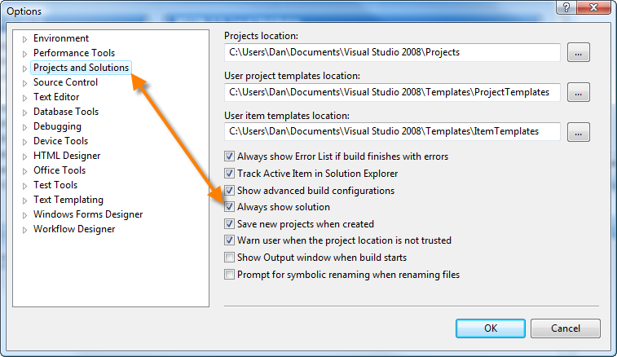
Always Show Solution

Slide 17
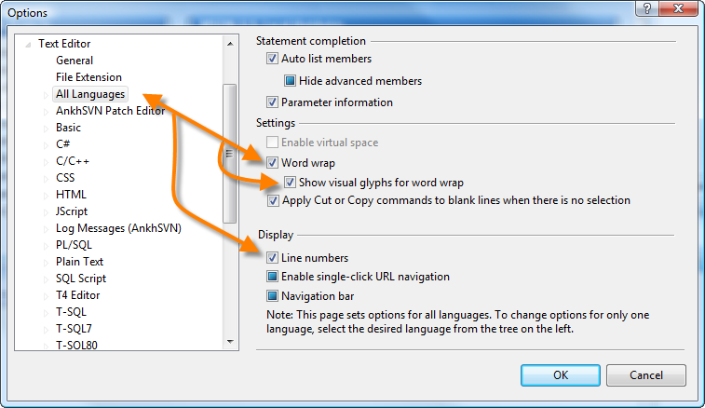
Text Editor – Line Numbers

Slide 18
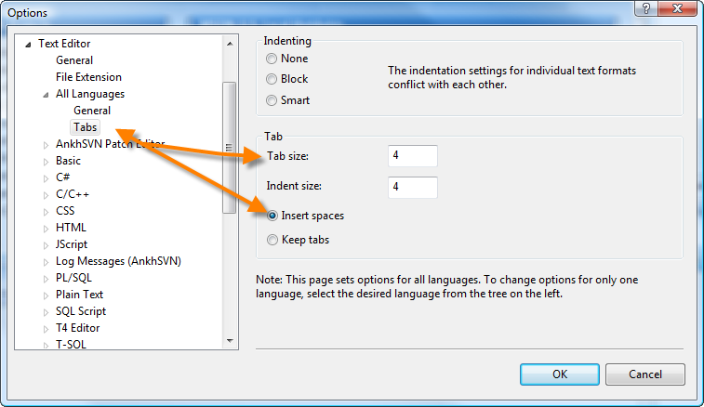
Text Editor - Tabs

Slide 19
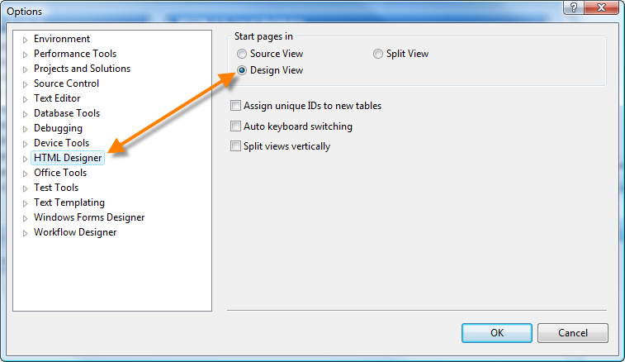
HTML Designer – Design/Split

Slide 20
Demo

Slide 21

Questions and Answers

Slide 22
Day 1 – Exercises
Play with Visual Studio

Slide 23
1) Customizing Preferences
Use Tools -> Options… to set up preferences recommended by your instructor
Explore the other options available in Tools -> Options…

Slide 24
2) Creating Projects
List the files automatically generated when you create the following
New Project…
Console Application
Windows Application
Class Library
ASP.NET Web Application
New Web Site…
ASP.NET Web Site
Empty Web Site

Slide 25
3) Creating/Zipping Projects
[Make sure you’ve closed any open solutions]
Create a new Console Application
Project Name: “MyFirstProject”
Location: “C:\DMIT\YourName\DMIT104\”
Solution Name: “The Solution Folder”
Save All and Exit Visual Studio
File -> Save All
Close Visual Studio
Zip the Solution & Website
Check the folder “C:\DMIT\YourName\DMIT104\The Solution Folder\” It should have:
Two files:
Sample Solution.sln
Sample Solution.sou
One folder:
MyFirstProject
Zip the “Practice” folder & email it to your instructor
Open the .zip before emailing, and ensure all the items are present
Email the .zip using your NAIT Email account

Slide 26
4) Review your understanding
Complete the following:
Define the term IDE
List the key tools available in Visual Studio 2008
Describe the relationship between Solutions, Projects and Files in Visual Studio 2008
List three different types of projects in Visual Studio 2008
List three different web site templates in Visual Studio 2008
Describe the following parts of the Visual Studio IDE:
Editor Window, Toolbox, Solution Explorer
Identify the file extension for a Solution file

